Slide 1
PHP 5.6 < > 7.0
Presented by Ivan Pavlov

Slide 2

Overview
- Enhancements
- Performance
- New Features

Slide 3
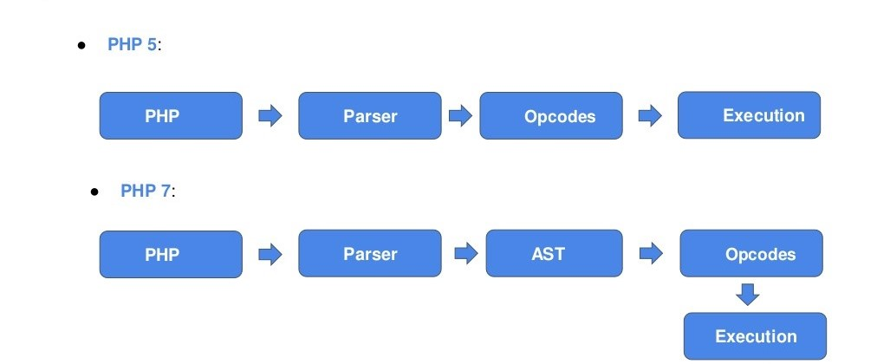
Enhancements

Slide 4
Tokenizing(Lexing)
function foobar(int $a)
{
return 1 + $a;
}
This sequence is split into tokens :
function, foobar , ( , int , $a , ) , { , return, 1, + , $a , }

Slide 5
Parsing + AST
{
type: 'function_decl',
name: 'foobar',
params: {
type: 'function_param_list',
children: [
{
type: 'parameter',
name: 'a',
typehint: 'int'
}
]
}

Slide 6
body: {
type: 'statement_list',
children: [
{
type: 'return_statement',
expression: {
type: 'add',
op1: {
type: 'integer',
value: 1
},
op2: {
type: 'variable',
name: 'a'
}
…….

Slide 7
Compilation

Slide 8
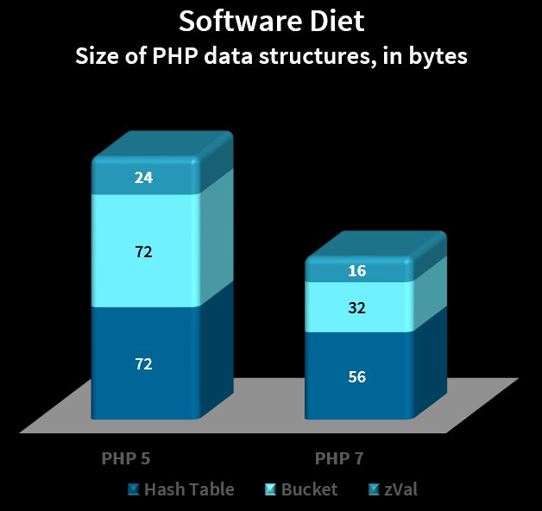
Enhancements

Slide 9
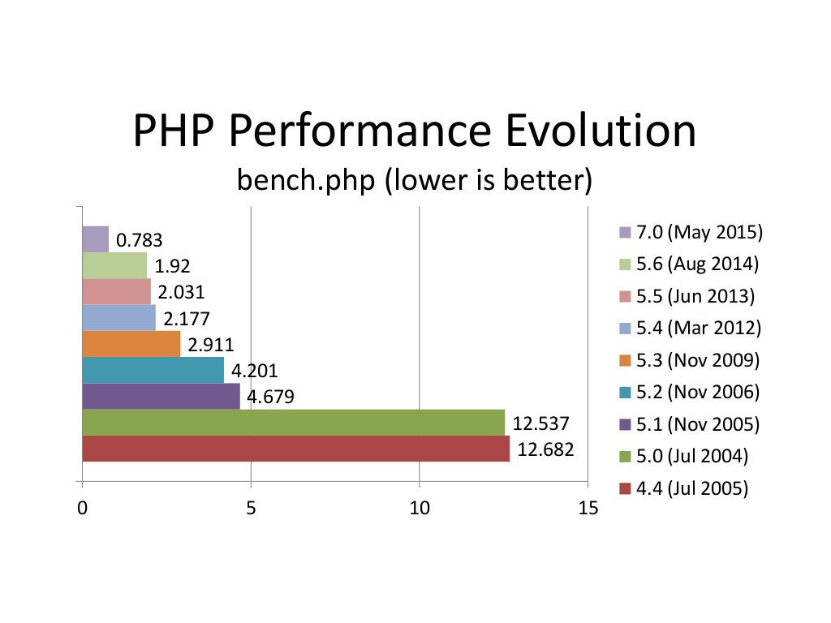
Performance
In php
3 this took 75 seconds

Slide 10
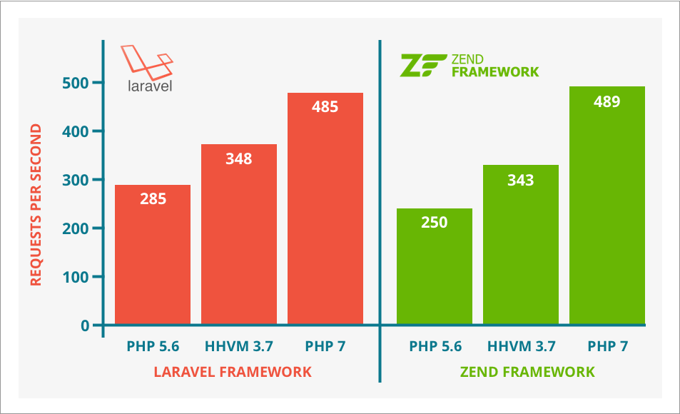
Performance

Slide 11
New features
Easily recover from Errors and Exceptions
Return type declarations and scalar type hints
Nullable types and void return type
Spaceship operator
Null coalescing operator

Slide 12
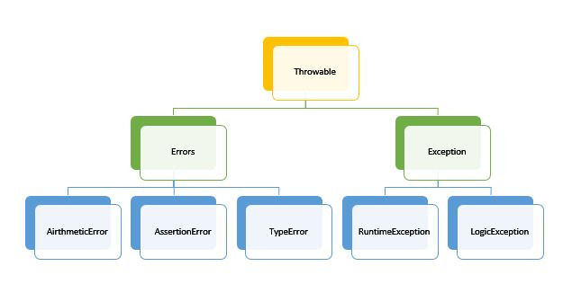
Error handling

Slide 13

Spaceship operator
(expr1)
(expr2)

Slide 14

Null coalescing

Slide 15

Demo

